Slide 1
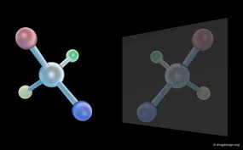
Stereochemistry

Slide 2
Isomerism
Isomerism is the phenomenon in which more than one compounds have the same chemical formula but different chemical structures.
Chemical compounds that have identical chemical formulae but differ in properties and the arrangement of atoms in the molecule are called isomers. Therefore, the compounds that exhibit isomerism are known as isomers.
The word “isomer” is derived from the Greek words “isos” and “meros”, which mean “equal parts”. This term was coined by the Swedish chemist Jacob Berzelius in the year 1830.

Slide 3
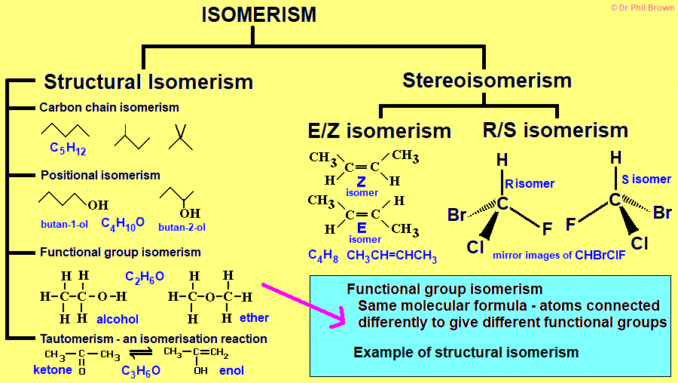

Slide 4
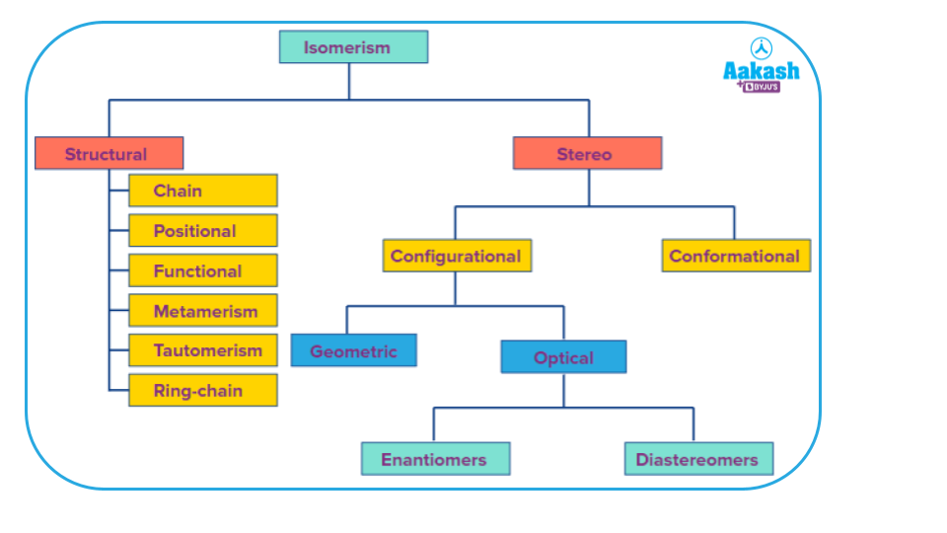

Slide 5
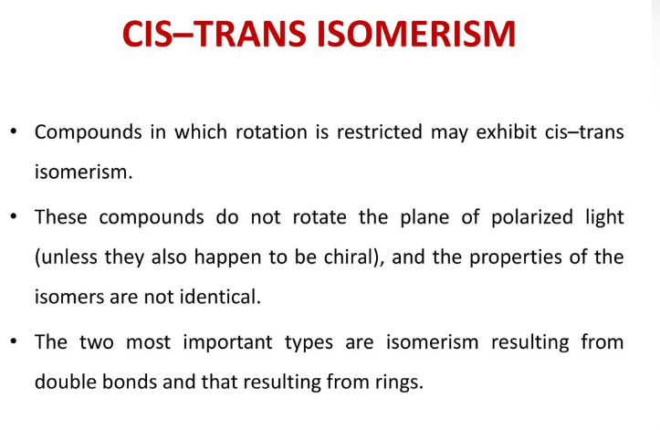

Slide 6
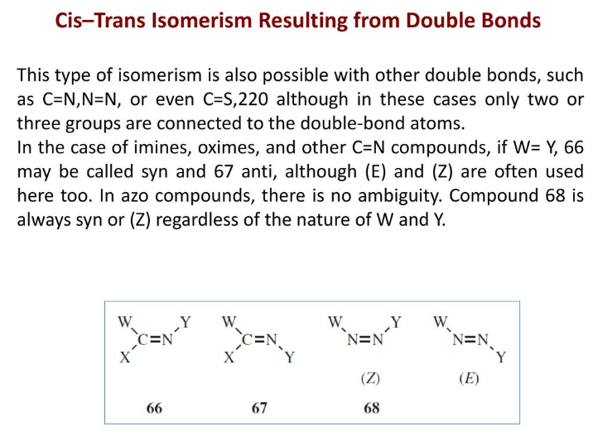

Slide 7
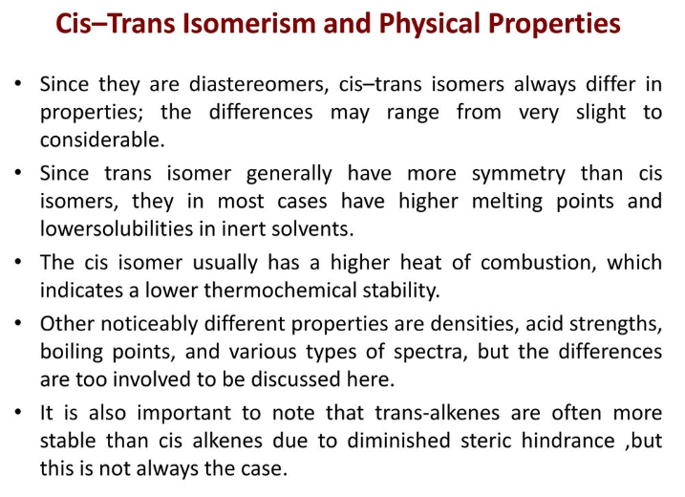

Slide 8
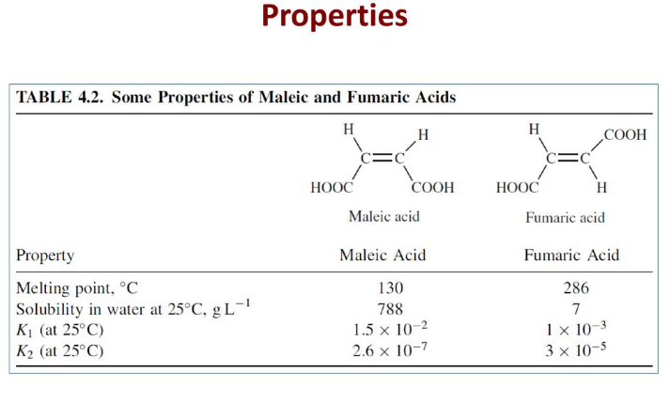

Slide 9
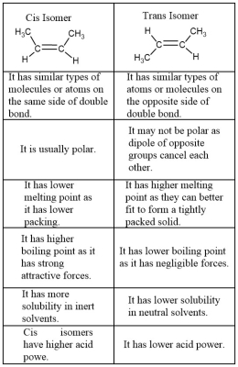

Slide 10
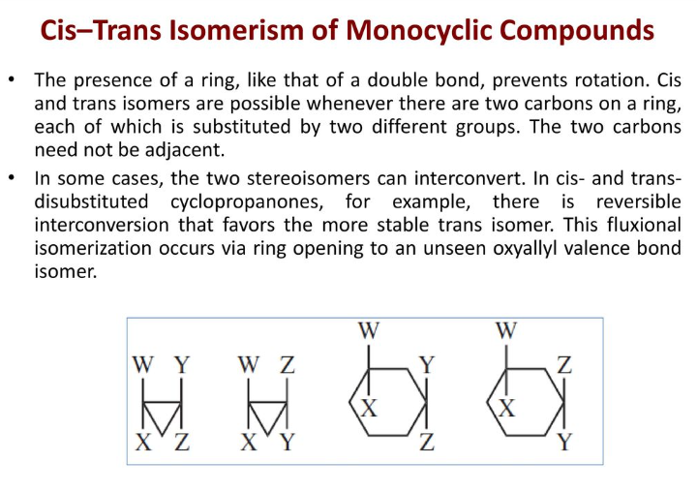

Slide 11
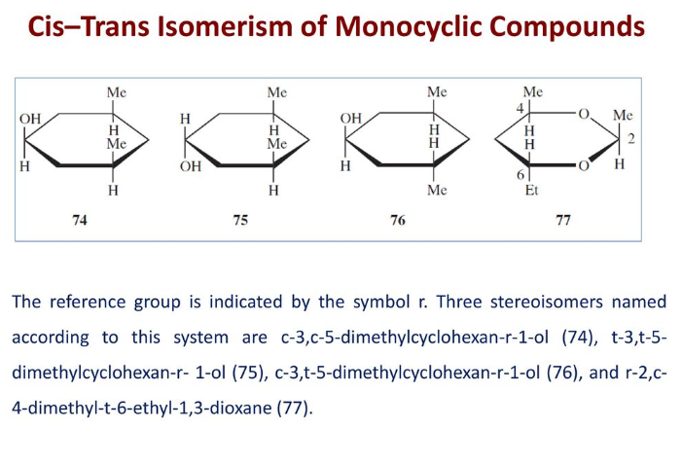

Slide 12
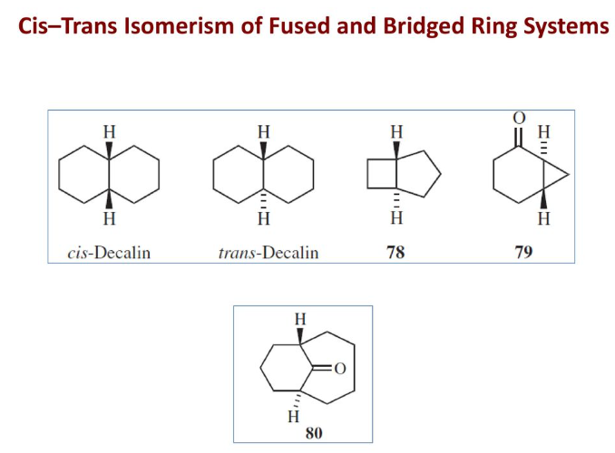

Slide 13
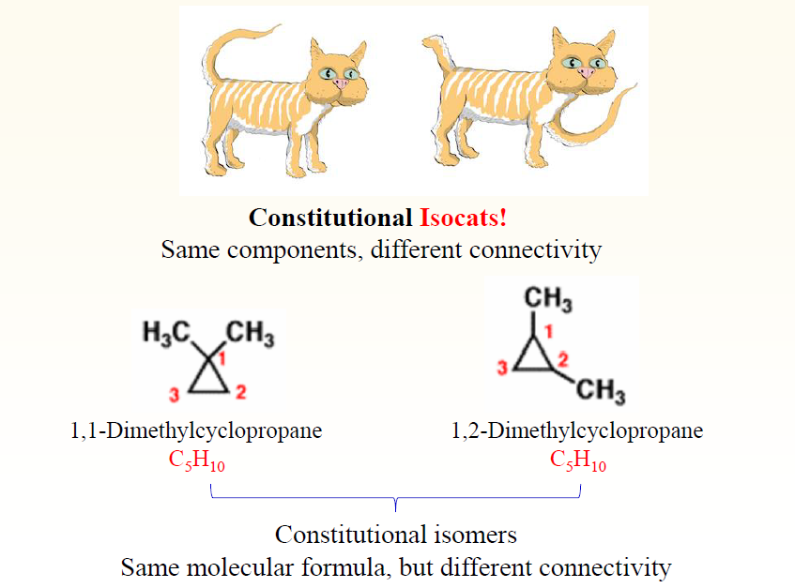

Slide 14
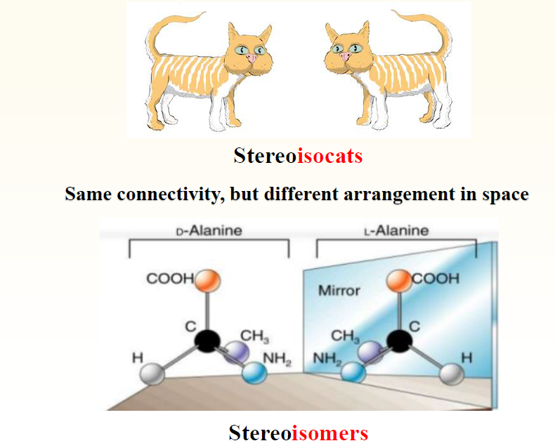

Slide 15
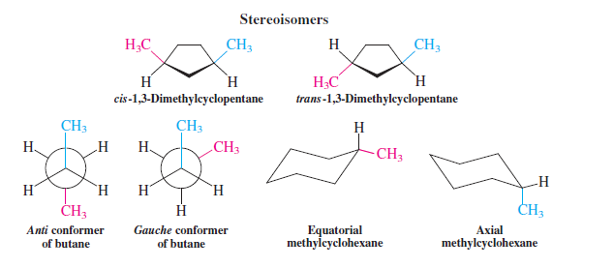
Stereoisomerism describes isomers whose atoms are connected in the same order but
differ in their spatial arrangement. Examples of stereoisomers include the relatively stable
and isolable cis-trans isomers and the rapidly equilibrating (and usually not isolable) conformational ones.

Slide 16
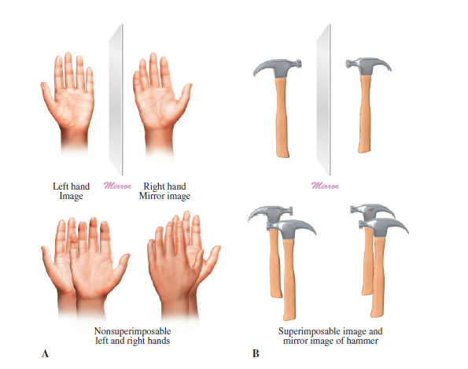

Slide 17
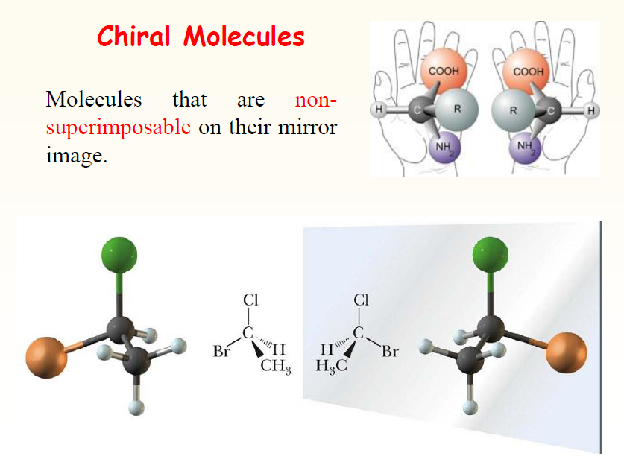

Slide 18
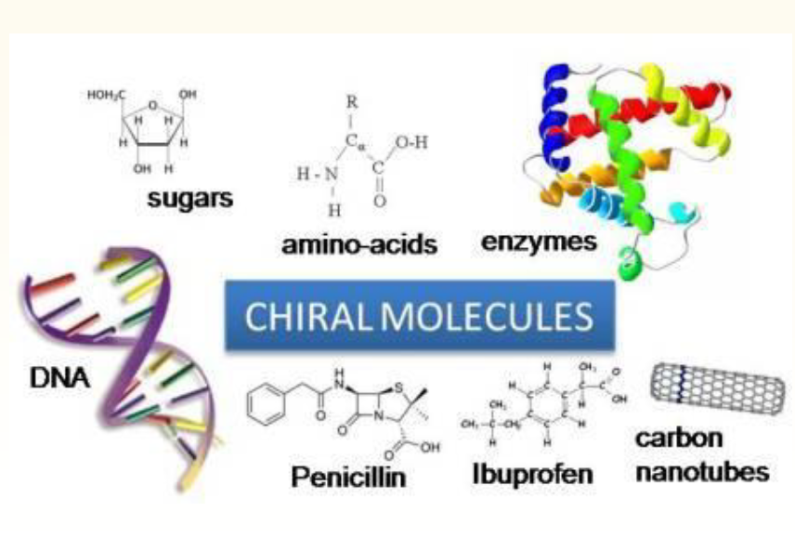

Slide 19
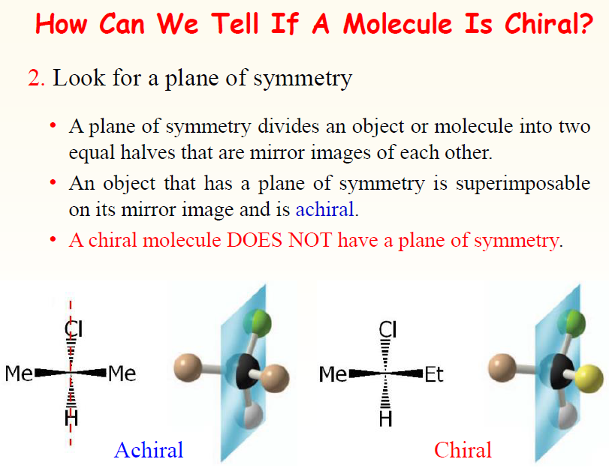

Slide 20
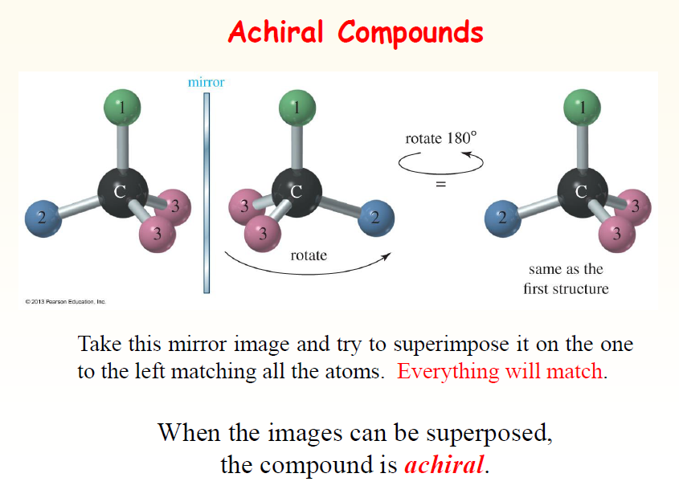

Slide 21
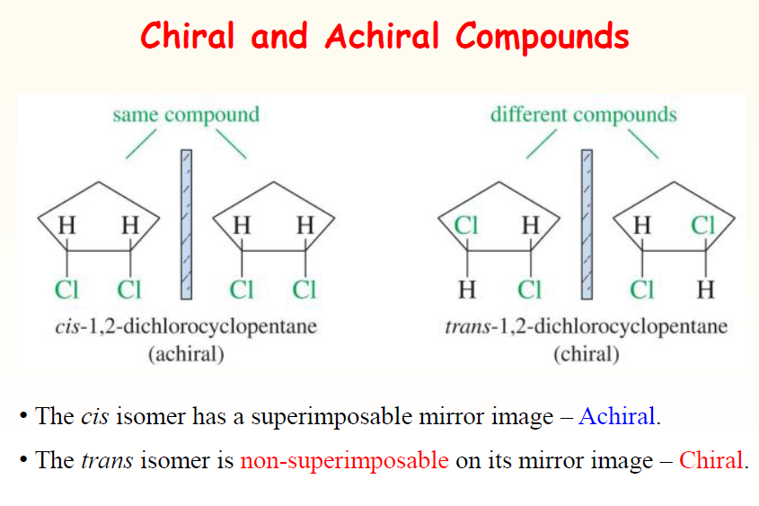

Slide 22
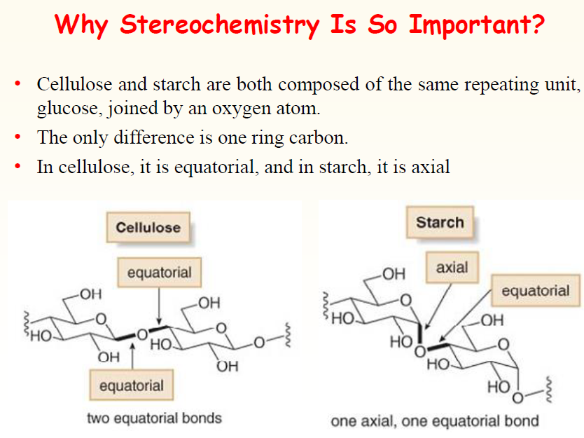

Slide 23
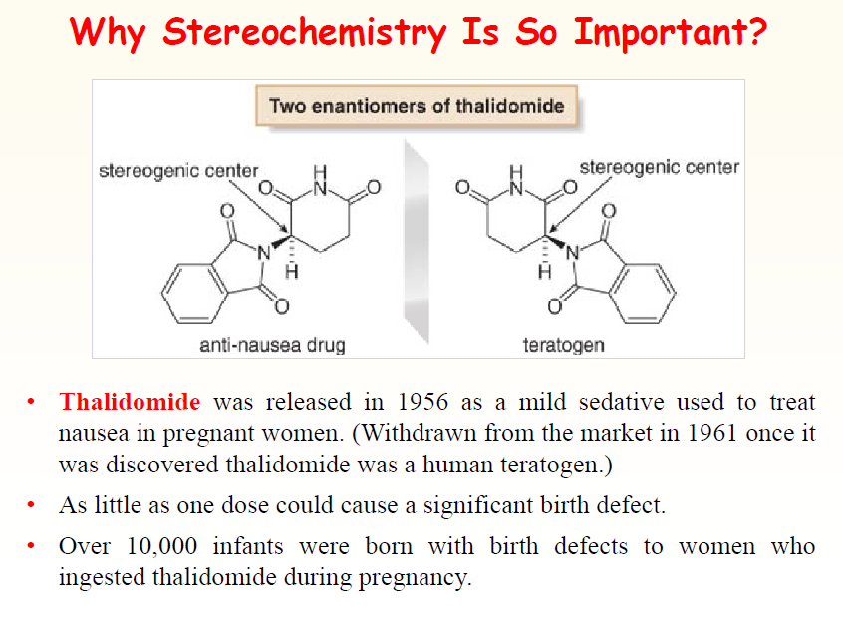

Slide 24
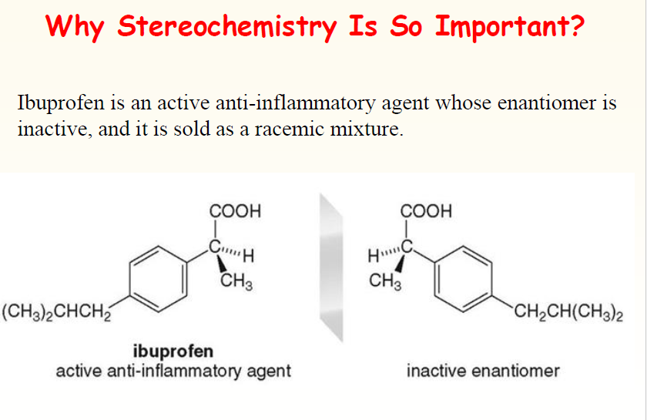

Slide 25

Enantiomers are chiral.
A pair of enantiomers has the same physical and chemical properties in achiral environment.
Enantiomers will rotate the plane of polarization in exactly equal amounts (same magnitude) but in opposite directions.
Plane polarized light is in fact an equal mixture of left and right circularly polarized light which propagates through space as left handed and right handed helices respectively.
In chiral environment such as chiral reagents or enzyme enantiomers reacts differently. So different biological properties.

Slide 26
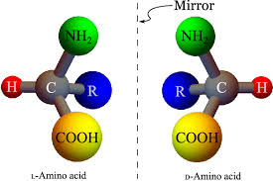
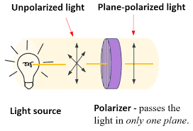
Enantiomers

Slide 27
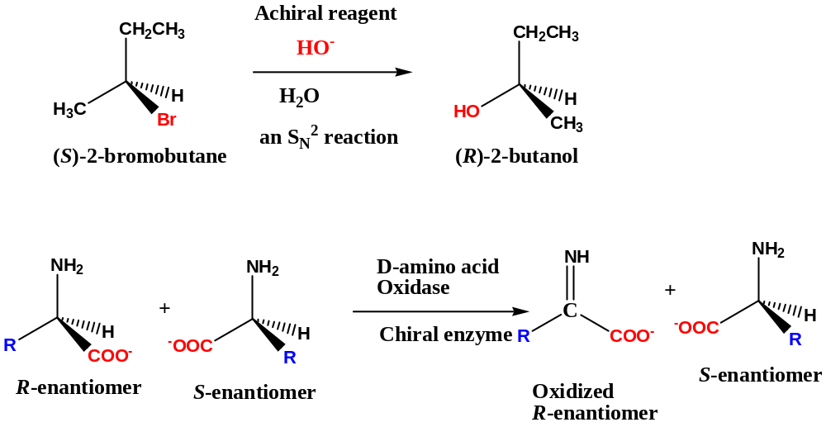
Reaction Of Enantiomers with Chiral/Achiral Reagents

Slide 28
Measuring Optical Activity
When rotation is quantified using a polarimeter it is known as an observed rotation, because rotation is affected by path length (l) the time the light travels through a sample and concentration (c) how much of the sample is present that will rotate the light. When these effects are eliminated a standard for comparison of all molecules is obtained, the specific rotation, [⍺].
[⍺] = 100⍺/ cl , when concentration is expressed as g sample /100ml solution
Specific rotation is a physical property like the boiling point of a sample Enantiomers will rotate the plane of polarisation in exactly equal amounts (same magnitude) but in opposite directions.
Dextrorotary designated as d or (+), clockwise rotation (to the right)
Levorotary designated as l or (-), anti-clockwise rotation (to the left)
If only one enantiomer is present a sample is considered to be optically pure. When a sample consists of a mixture of enantiomers, the effect of each enantiomer cancels out, molecule for molecule.

Slide 29
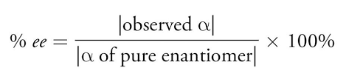
In stereochemistry, Enantiomeric excess (ee) is a measurement of purity used for chiral substances. It reflects the degree to which a sample contains one enantiomer in greater amounts than the other. A racemic mixture has an ee of 0%, while a single completely pure enantiomer has an ee of 100%. A sample with 70% of one enantiomer and 30% of the other has an ee of 40% (70% − 30%).

Slide 30
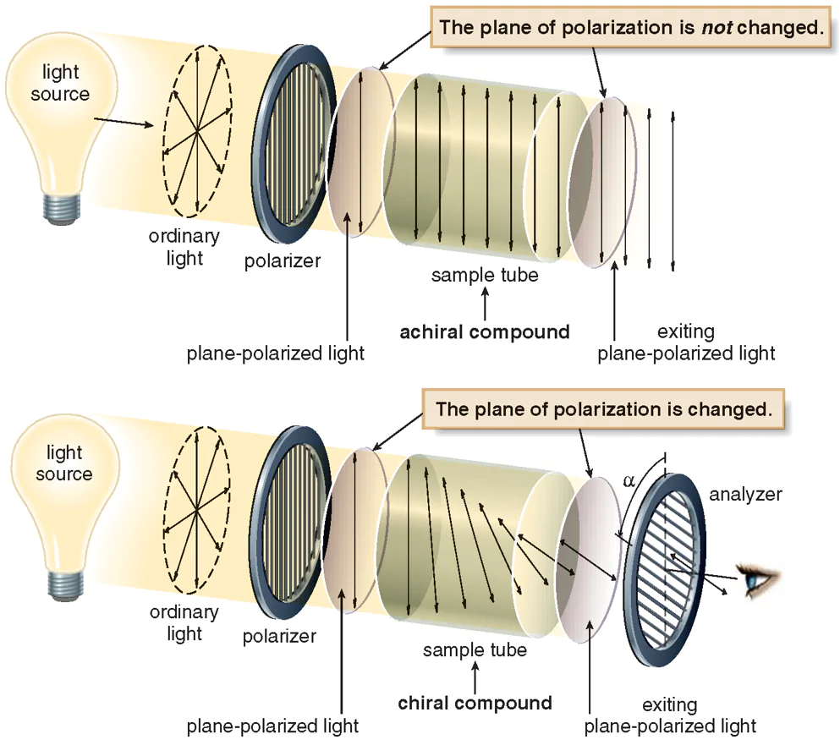

Slide 31
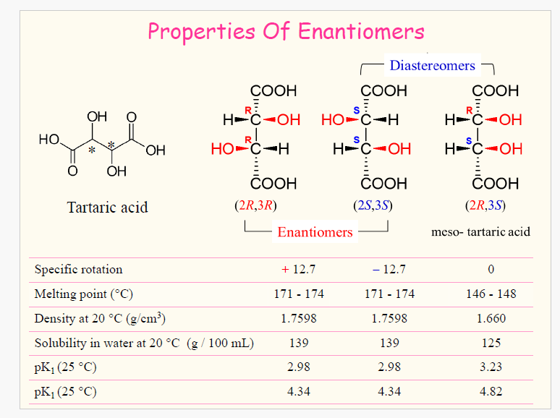

Slide 32
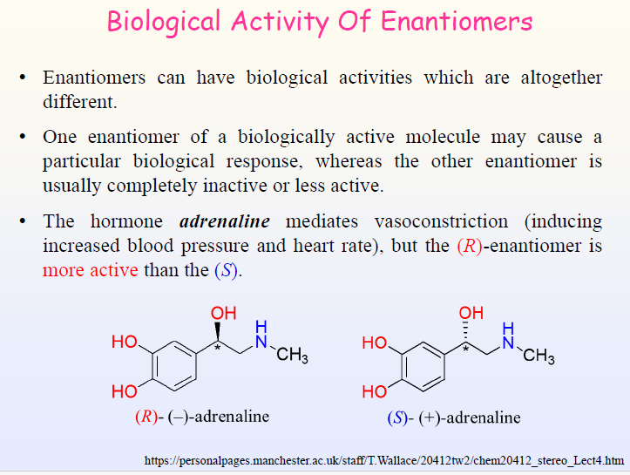

Slide 33
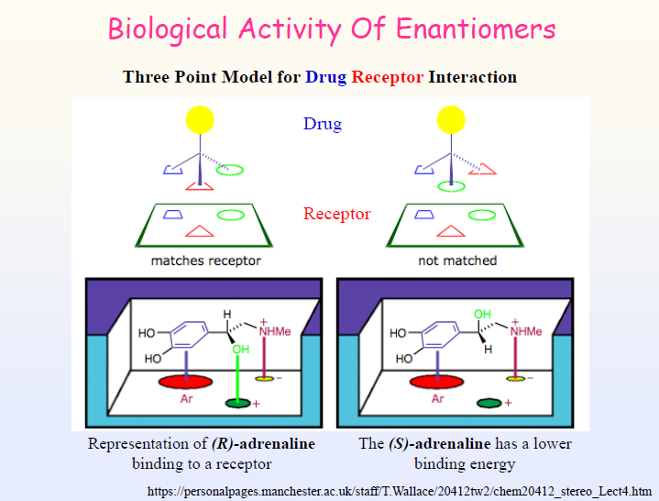

Slide 34
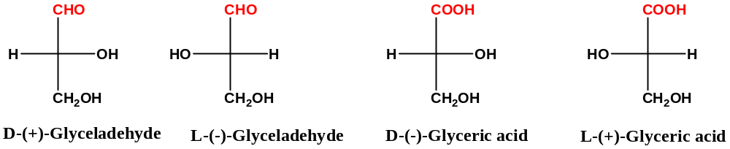
Rosanoff proposed that one compound be chosen as standard and a configuration be arbitrarily assigned to it.
The Compound chosen glyceraldehyde because it related to carbohydrate (sugar).
The right-OH group containing Glyceraldehyde label as D and left one L.
Molecules with the same configuration need not rotate the plane of polarized light in the same direction.

Slide 35
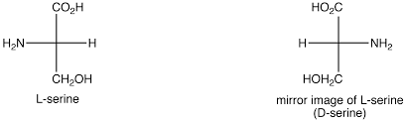
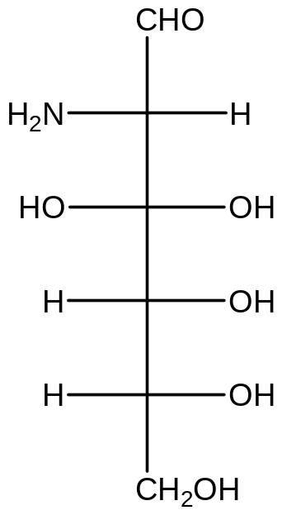
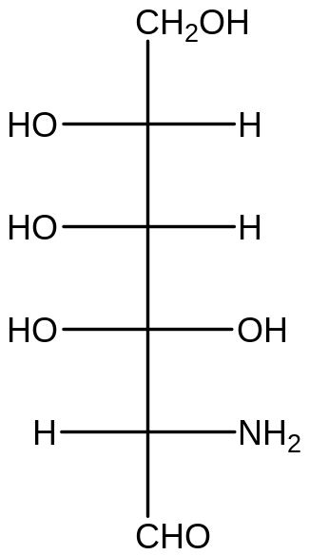
180⁰ rotation
Dg configuration with respect to glyceraldehyde and Ls configuration with respect to serine
2-amino-2-deoxymannoic acid

Slide 36
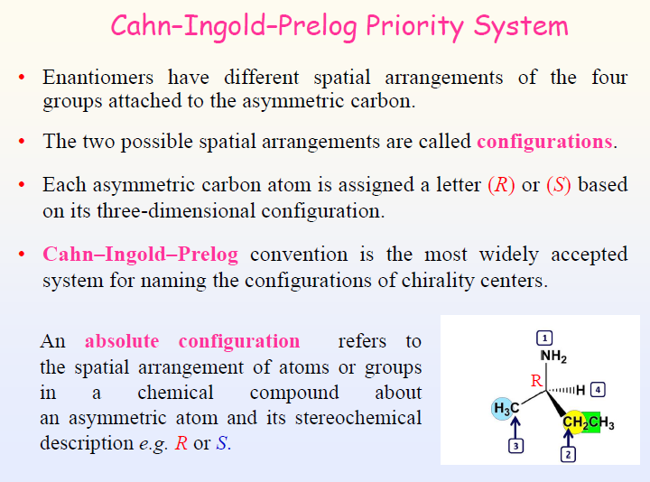

Slide 37
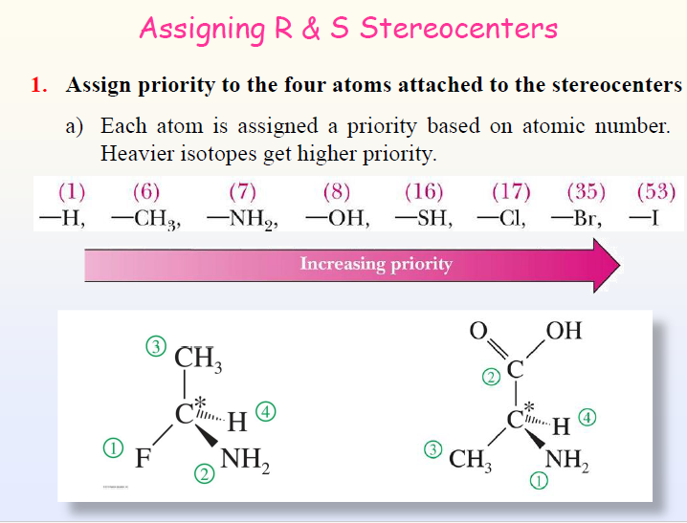

Slide 38
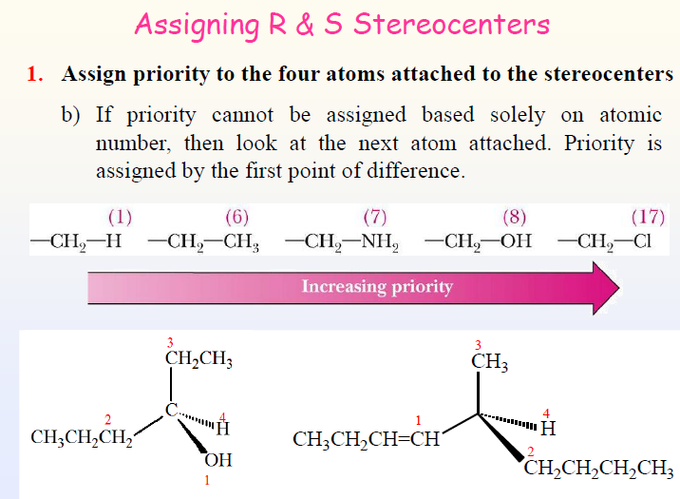

Slide 39
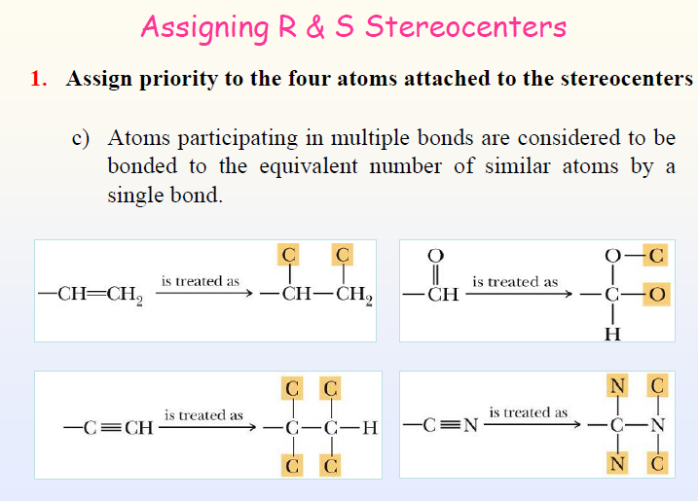

Slide 40
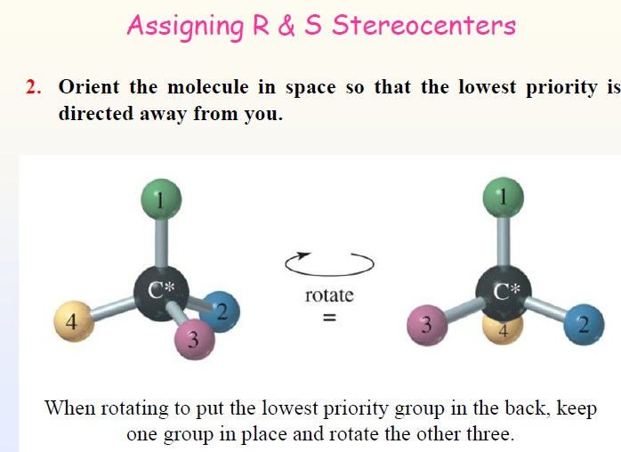

Slide 41
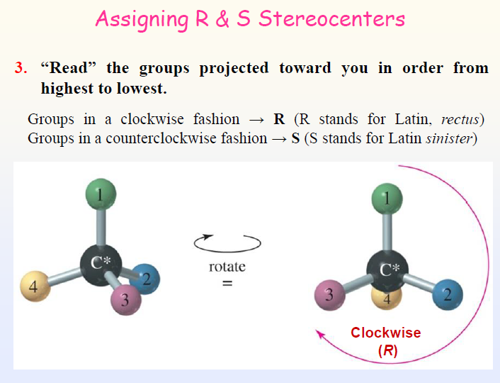

Slide 42
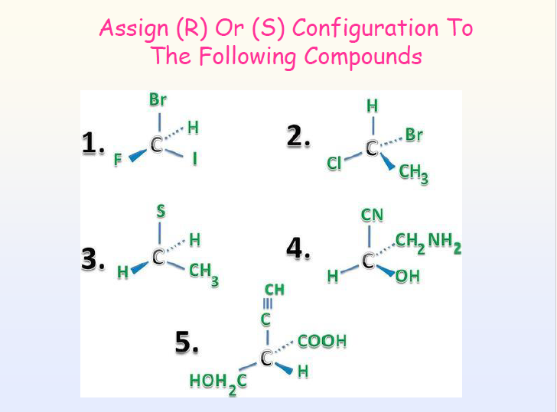

Slide 43
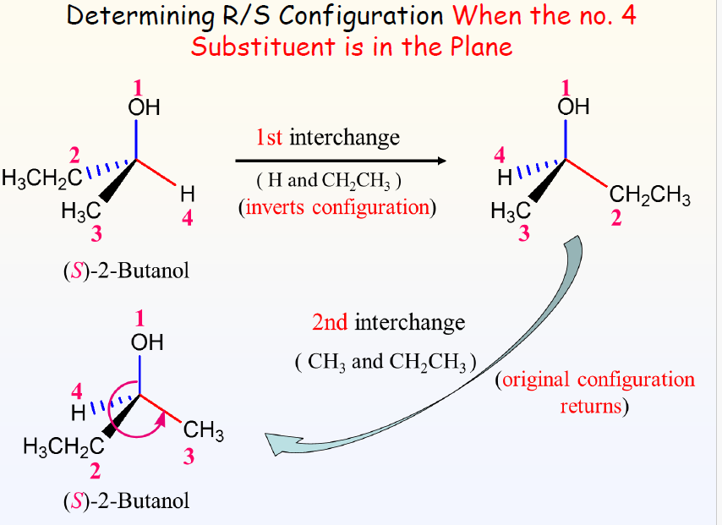

Slide 44
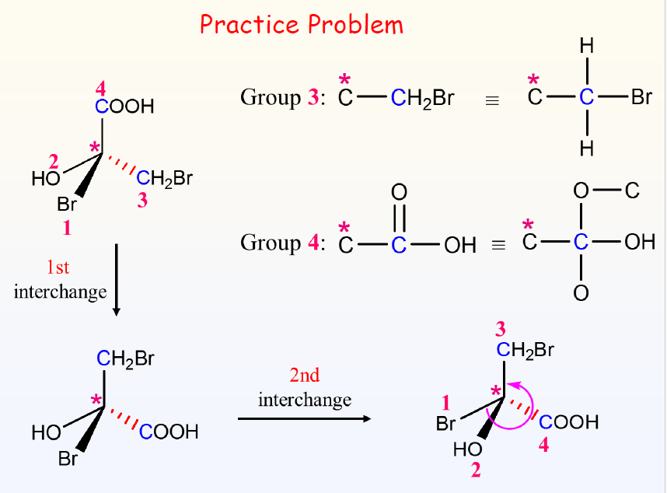

Slide 45
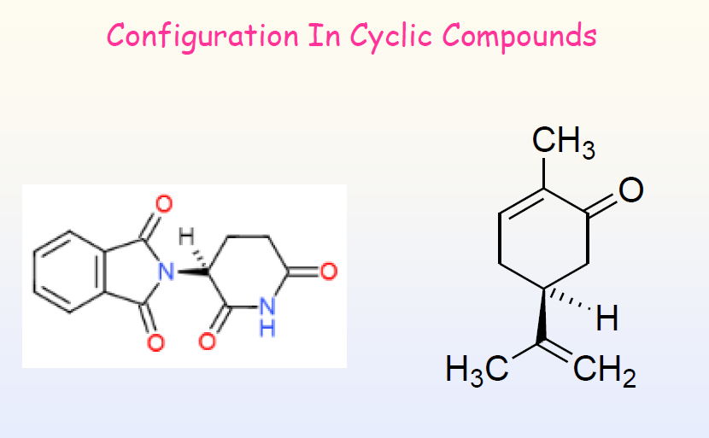

Slide 46
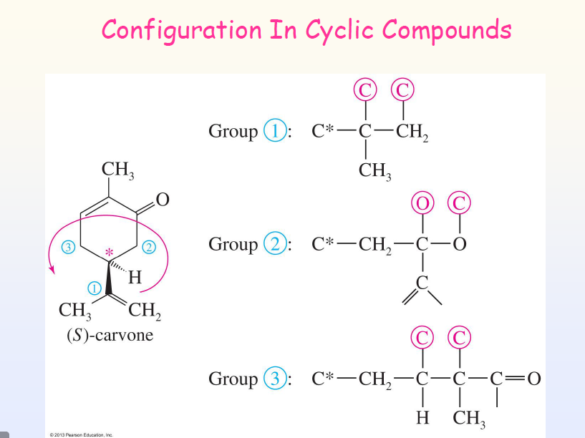

Slide 47
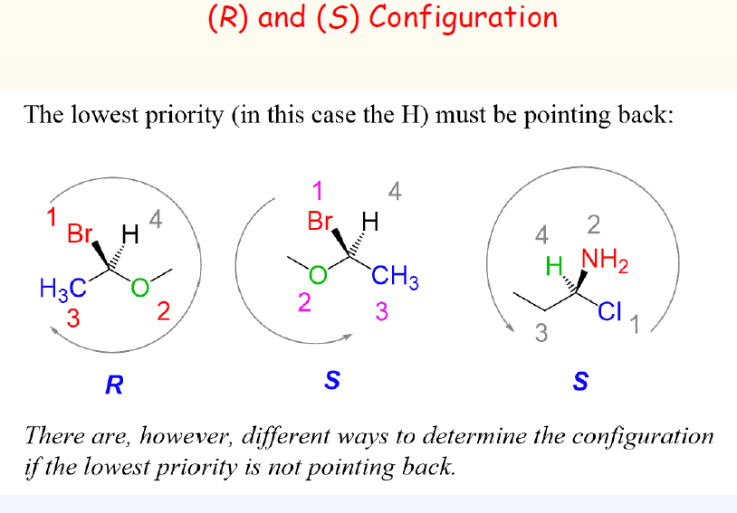

Slide 48
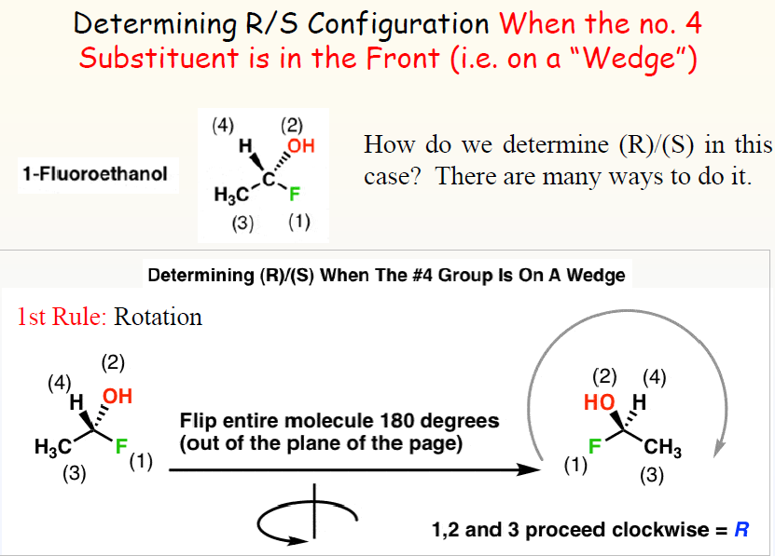

Slide 49
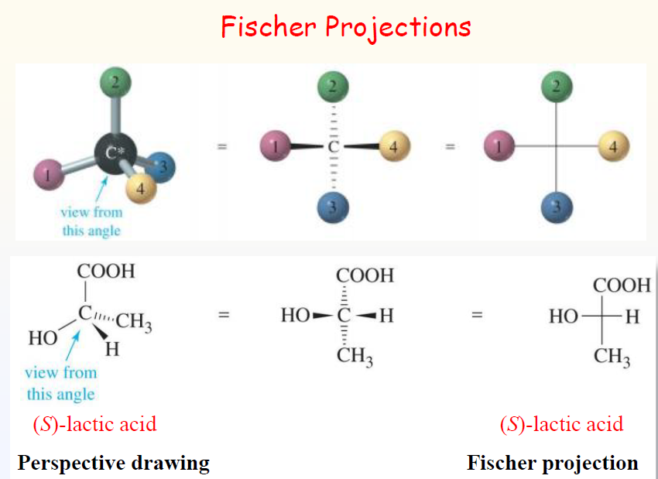

Slide 50
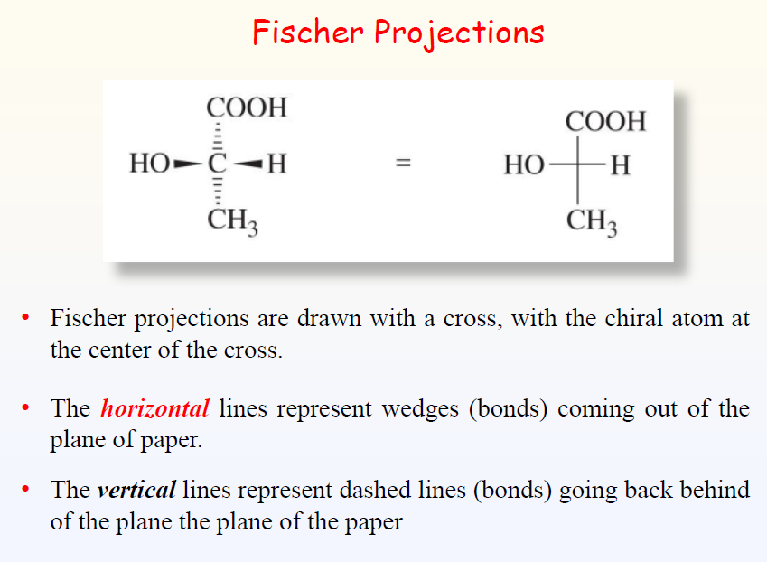

Slide 51


Slide 52


Slide 53


Slide 54


Slide 55


Slide 56
Diastereomers
Diastereomers are two molecules which are stereoisomers (same molecular formula, same connectivity, different arrangement of atoms in space) but are not enantiomers. Unlike enantiomers which are mirror images of each other and non-superimposable, diastereomers are not mirror images of each other and non-superimposable. Diastereomers can have different physical properties and reactivity. They have different melting points and boiling points and different densities. In order for diastereomer stereoisomers to occur, a compound must have two or more stereocenters

Slide 57



Slide 58

S.No | Property | Enantiomers | Diastereomers
1 | Melting point | Identical Melting point | Different Melting point
2 | Boiling point | Identical Boiling point | Different Boiling point
3 | Solubility | Same | Different
4 | Optical rotation | Same, but opposite sign | Different values may have the same or opposite sign
5 | Chemical properties | Similar | May be different
6 | Free energy | Same | Different

Slide 59


Slide 60
Enantiomeric resolution
Chiral resolution, or enantiomeric resolution, is a process in stereochemistry for the separation of racemic mixture into their enantiomers. It is an important tool in the production of optically active compounds, including drugs. Another term with the same meaning is optical resolution.
Chiral Resolution
As noted earlier, chiral compounds synthesized from achiral starting materials and reagents are generally racemic (i.e. a 50:50 mixture of enantiomers). Separation of racemates into their component enantiomers is a process called resolution. Since enantiomers have identical physical properties, such as solubility and melting point, resolution is extremely difficult. Diastereomers, on the other hand, have different physical properties, and this fact is used to achieve resolution of racemates. Reaction of a racemate with an enantiomerically pure chiral reagent gives a mixture of diastereomers, which can be separated.

Slide 61


Slide 62
Resolution via salt formation (ionic bonding)
The simplest examples of resolution involve the neutralisation of acids or bases in order to convert them into a separable pair of diastereoisomeric salts. This is the easiest method of resolution and has often been used for the resolution of racemic acids (using an amine as the resolving agent) and bases (using an acid as the resolving agent). This type of resolution is generally efficient for the following reasons:
Diastereoisomeric salts can often be separated by crystallisation. Recrystallisation gives high diastereoisomeric purity and the process is practical on a large scale.
The pure enantiomers can easily be separated from the resolving agent at the end of the process by simple solvent (acid/base) extraction, which is again practical on a large scale.

Slide 63


Slide 64

Meso Compound
A meso compound is a stereoisomer with two or more chiral centers but no optical activity due to an internal plane of symmetry. Mesomers are compounds with zero net rotation of plane polarised light. Organic molecules that have two chiral carbons that are identical, resulting in zero net rotation are called mesomers.
Two or more stereocenters.
An internal plane of symmetry, or internal mirror, that lies in the compound.
Stereochemistry that cancels out. This means reflected stereocenter should have the same substituents and be inverted. For instance, in a meso compound with two stereocenters one should be R and the other S.

Slide 65




Meso Compound Example

Slide 66

The general strategy of the E-Z system is to analyze the two groups at each end of the double bond. At each end, rank the two groups, using the CIP priority rules. Then, see whether the higher priority group at one end of the double bond and the higher priority group at the other end of the double bond are on the same side (Z, from German zusammen = together) or on opposite sides (E, from German entgegen = opposite) of the double bond.

Slide 67

This is 2-bromo-2-butene ignoring the geometric isomerism for now. Cis or trans? This molecule is clearly cis. The two methyl groups are on the same side. More rigorously, the "parent chain" is cis.
E or Z? There is a methyl at each end of the double bond. On the left, the methyl is the high priority group because the other group is -H. On the right, the methyl is the low priority group because the other group is -Br. That is, the high priority groups are -CH₃ (left) and -Br (right). Thus the two priority groups are on opposite sides = entgegen = E

Slide 68



(Z)-1-chloro-2-ethyl-1,3-butadiene.
(2E)-2-(1-bromoethylidene)pent-3-ynyl methyl ether

Slide 69

A pseudo-asymmetric centre is found in a meso molecule where a plane of symmetry runs through a stereogenic centre and that stereogenic centre’s two substituents are constitutionally the same (same atoms connected by the same type of bonds) but configurationally different (spatially different). In this situation the substituent with R has a higher priority than the substituent with S and the pseudo-asymmetric centre is described as r or s.

Slide 70


IR spectroscopy can differentiate between diastereomers like ephedrine and pseudoephedrine based on their unique spectral "fingerprints.

Slide 71

Conformation:
Conformations are different spatial arrangements of atoms within a molecule that can be interconverted through rotation around single bonds.
These arrangements are dynamic and can change readily at room temperature, as the molecule can rotate freely around the single bonds.
Examples of conformational isomers include staggered and eclipsed conformations of ethane.

Slide 72



Slide 73

Configuration:
Configuration describes the permanent, fixed arrangement of atoms within a molecule.
Changing the configuration of a molecule requires breaking and reforming bonds.
Examples of configurational isomers include cis and trans isomers, or enantiomers (mirror images).

